Slide 1

Should you invest in Nursing Homes?
Analysis by: Diana Manukyan
Julian Amberg
Jeffrey Brown
BANA620: Group Project

Slide 2

Table of contents
01
02
Introduction and Project Overview
Methodology and Data Description
03
04
Analysis and Findings
Recommendations and Conclusion

Slide 3

01
Introduction and Project Overview

Slide 4

Context
→ The U.S. is experiencing an increased demand for elder care services due to the aging baby boomer population.
→Nursing homes are becoming a focal point for both private investment and public health planning.
Opportunity:
→ If the industry proves to be financially sustainable and resilient to shocks (e.g., COVID-19), it could offer strong long-term returns for investors.

Slide 5


Project Purpose and Objectives
Purpose:
Determine whether it is advisable for our client to invest in nursing homes.
Objectives:
Evaluate overall financial performance of U.S. nursing homes (2015–2021)
Identify the key factors influencing financial outcomes
Determine which factors are most significant
Analyze long-term trends in performance and drivers
Examine the impact of COVID-19 on the sector

Slide 6
Project Purpose and Objectives
Why this Matters:
Helps make data-driven investment choices in a high-stakes, expanding sector.
Supports strategy development for a sector critical to the well-being of an aging population.
Helps stakeholders understand the financial dynamics and risk factors in long-term care.

Slide 7
02
Methodology and Data Description

Slide 8

Methodology
Data Collection
Data Analysis Techniques
Data sourced from CMS via Provider Data Catalog and Care Compare
Covers 2015–2021, across financial, quality, staffing, and inspection metrics
All data was in CSV format
Descriptive Statistics
Correlation Analysis
Trend & Time-Series Analysis
Regression Modeling (OLS)
Categorical Modeling (Logistic, Decision Tree, Random Forest)
Machine Learning (Random Forest, Lasso, Ridge, ElasticNet)
COVID-19 Impact Assessment

Slide 9

Datasets
01 CostReport | Gives data on financial performance and expenses, including total revenue, operating expenses, profit margins, and capital costs.
02 ProviderInfo | Includes facility details on nursing homes, such as facility name, address, ownership type, capacity, and certification status.
03 HealthDeficiencies | Provides information on inspection violations and deficiency tags, categorized by type, severity, and date.
04 QualityMsrMDS | Gives metrics for the quality of care obtained from MDS evaluations, including but not limited to mobility decline and infection rates.
05 Penalties | Include information about fines and other enforcement measures that noncompliant facilities face.

Slide 10

Data Preprocessing
Cost Reports: Data Preparation & Feature Engineering
We combined yearly cost report files (2015–2021) into one dataset using Python and added a Year column to add to the composite key (rec_rpt_num, provider_ccn, year).
Column names were inconsistent across years, so we renamed them to allow for merging.
We created new columns to total up different types of discharges, since there wasn’t a direct patient count. And this leads into our main variable below.
Net Income per Discharge —we used it as a stand-in for financial performance per patient.
We dropped rows missing that target value or missing more than half their data. Then we filled in missing numbers with the median, and dropped the categorical variables.

Slide 11
Data Preprocessing
Cost Reports: Modeling and Analysis
All variables were converted to numeric types, and features were standardized to ensure fair weighting during modeling.
Two modeling approaches were used:
Linear regression with backward elimination to identify statistically significant predictors of financial performance.
Random forest to capture non-linear relationships and determine the relative importance of each variable.
We linked Cost Reports and Provider Info datasets using a composite key of rpt_rec_num, provider_ccn, and year.
This helped to conduct a thorough examination of financial performance and quality measures.

Slide 12
Data Preprocessing
Provider Info, Health Deficiencies, Quality Measurements, Penalties
Pre-processing
Adding the year column to CSVs
Provider Info
Serves as base file to merged onto (has primary composite key of Provider Federal Number and Year)
Remove null values
IQR Outlier-reduction
Health Deficiencies
Information can be summarized via estimating a Deficiency Count
Calculated by counting the number of deficiency tags per provider

Slide 13
Data Preprocessing
Provider Info, Health Deficiencies, Quality Measurements, Penalties
Quality Measurements
Most important elements: quality measure descriptions, stay type, measure scores, and measure average
Determine the quality of the measure by grouping measures
Penalties
Take the count of penalties per provider for each year
Sum all fine amounts (nulls = 0)
One-hot Encoding
Score_High ← Categorization Model Target Variable
ZIPREGION, CERTIFICATION, & OWNERSHIP_TYPE
Missing Years
Providers were missing year instances in their ranges
Filled in missing years with median values

Slide 14

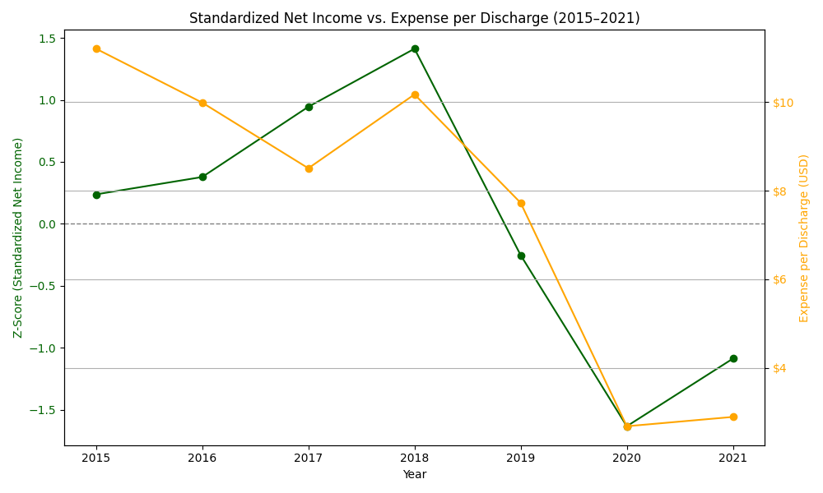
Diagnostics
Standardized Net Income increased gradually until 2018, after which point it began to fall dramatically in 2019.
Additionally, operating expenses per discharge decreased, most likely as a result of fewer treatments and patients during COVID.
Trends in income and expenses are strongly correlated, according to patterns.
Business became less financially sustainable and more unpredictable after 2019.

Slide 15
03
Analysis and Findings

Slide 16


OLS Regression
Multiple linear regression analysis:
Net Income per Discharge as the dependent variable to identify the primary financial factors that influence nursing home performance.
24 independent variables
Feature Selection Method:
Backward Elimination: using p-values to eliminate least significant predictors,
Significance threshold: p < 0.05
3 features removed as a result → final model: 21 variables

Slide 17
OLS Regression
Model Performance
R-squared: 0.545
Model explains approximately 54.5% of the variance in net income per discharge
Indicates a moderate but meaningful level of explanatory power, especially given the financial complexity of nursing homes
F-statistic: 5927, p-value ≈ 0
Confirms that the model provides a significantly better fit than a model using only the mean

Slide 18
OLS Regression
Key Findings
Positive Impact Factors
Revenue per Discharge: most influential positive variable → more patient revenue = more profit
Gross Revenue: positively associated with profitability
Discharge Volume: higher throughput correlates with better financial performance
Negative Impact Factors
Operating Expense per Discharge: strongest negative predictor
Total Costs and Staff Wages: also negatively impact net income

Slide 19

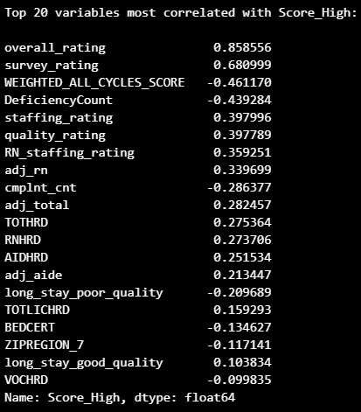
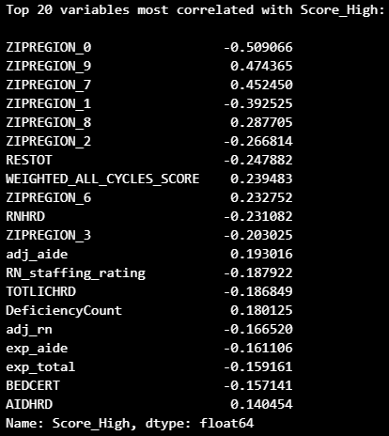
Categorization Models
Categorical Analysis:
Categorization Model Target Variable: Score_High to determine which variables will help predict a high overall rating for the provider
Manual Selection Method:
Opting to use data definitions, industry knowledge, and correlation coefficients to select the variables
The important variables selected for PreCOVID:
Deficiency Count
Staffing Rating
Quality Rating
Adj_total
COVID-19 Variables:
The most correlated variables are the ZIPREGIONs
Prefer to use PreCOVID variables
Running the model w/regions as independents produces an inaccurate model (accuracy scores = 1.00)

Slide 20
Categorization Models
PreCOVID-19 Results
Accuracy:
Logistic Regression = .80
Decision Tree = .84
Random Forest = .88
Precision: .80-.89
Recall: .84-.91
F-score: .82-.90
COVID-19 Results
Accuracy:
Logistic Regression = .71
Decision Tree = .79
Random Forest = .85
Precision: .74-.88
Recall: .79-.87
F-score: .76-.87
INSIGHTS
Both the PreCOVID-19 and COVID-19 results suggests that the four variables (+ additional variables) meaningfully predict a provider receiving a high score.
COVID-19 did not change the general importance of the prior measures dictating an overall rating (meaning data is operating as expected and can be used for further analysis) .

Slide 21


Random Forest Analysis
What it does and why it is useful
An alternative to the OLS regression to explore complex, nonlinear relationships
Builds multiple decision trees on random subsets of data
Averages outputs to improve prediction accuracy and prevent overfitting
Captures nonlinear patterns between costs, discharges, staffing, and net income
Handles high-dimensional financial data better than linear methods

Slide 22
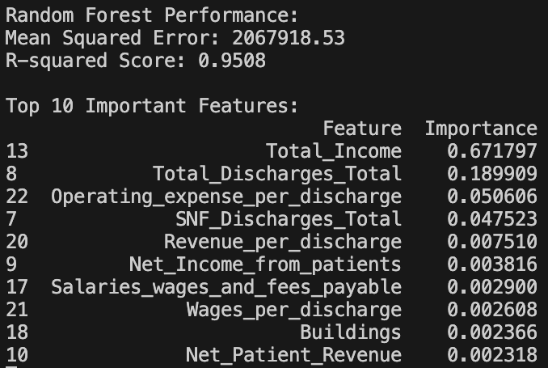
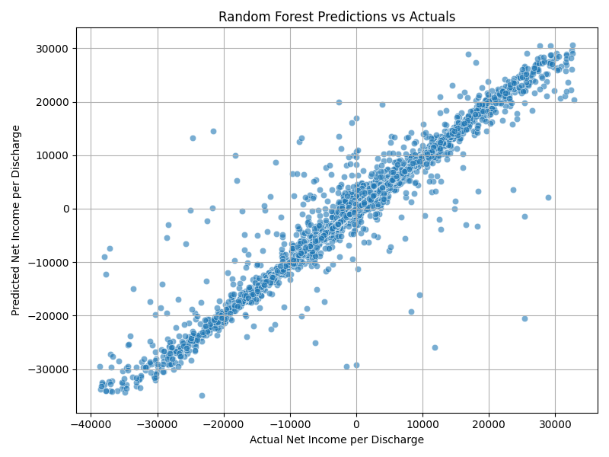
Random Forest Analysis
Results: Version 1
R-squared: 0.9508 => the model accounted for nearly 95% of the variation in net income per discharge
Scatter Plot:
Some extreme outliers, possibly tied to unmeasured factors (e.g., management quality) -> masked
Displayed a strong diagonal pattern between actual and predicted values
Mean Squared Error (MSE): ~2.07 million, average of squared differences between predictions and actuals
Root Mean Squared Error (RMSE): ~$1,439, predictions are, on average, off by $1,439 per discharge

Slide 23
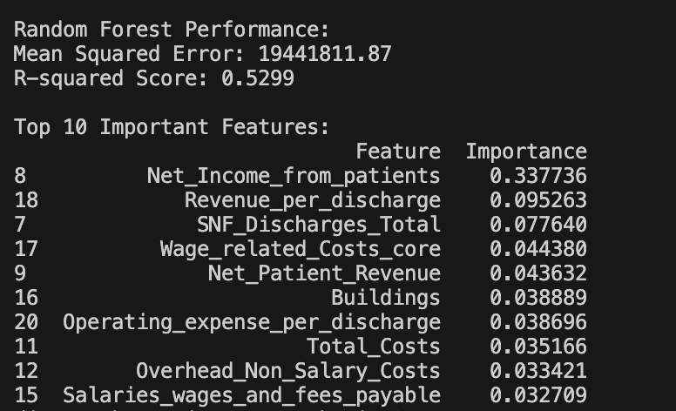
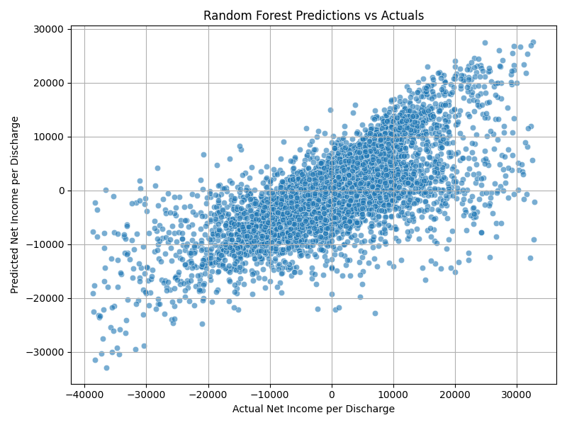
Random Forest Analysis
Results: Version 2
Removed variables that directly define the target (TI, TD)
R-squared: 0.5299 => the model accounted for nearly 53% of the variation in net income per discharge
Forecasting power decreased, but feature importance became more balanced
Scatter Plot:
Showed a more natural spread, but still maintained a positive correlation between actual and predicted values
Offers more reliable insights by avoiding artificial inflation of performance

Slide 24
Lasso/Ridge/Elastic Regression
Key drivers of higher income per discharge include Medicare certification, high staffing and facility ratings, and good quality short-term care.
Regions 2 and 9 outperformed others, likely due to stronger local economies which could mean the facilities have more funding.
Negative financial impacts were linked to high bed counts, excess staffing hours, and poor performance indicators (deficiencies, complaints, low scores). This could mean that these locations receive fewer subsidies in addition to the effects of bad word of mouth.
Government run facilities earned less per discharge compared to private ones. Not directly related to subsidies.
Overall profitability declined over time, with COVID-19 likely contributing to losses in the last two measured years.

Slide 25
04
Recommendations And Conclusion

Slide 26

Recommendations
We would not suggest our client to invest in the nursing home sector at this time.
Because:
Profitability has sharply declined and remains unstable
Net income per discharge is insufficient when considering overall patient volume
Performance varies by region, with most showing negative trends
The industry is too volatile, with margins too small to justify investment risk

Slide 27

Conclusion
The nursing home industry lacks financial stability and sustainable profit margins.
Business model is heavily burdened by rising expenses per resident.
Quality of care has declined across regions over time.
COVID-19 further exposed and intensified systemic weaknesses.
Overall, the sector presents a high-risk, low-return investment profile.

Slide 28
Thanks for your attention!

